Slide 1

Policy Recommendation Mascot Steel

Slide 2
Policy
Implement a Water Recycling Scheme to reduce daily water consumption by 95% by 2025.

Slide 3
Project analysis slide 4
Necessity
More Water
Increase in water within the environment.
Water Recycle System
Potable Water Available
Conservation
of Water
Reduce the Effects of CCE
Increase of potable water available.
Decrease Water Consumption
Help to reduce the effects of climate change on water availability.
Less Damage
Decrease in damage to natural ecosystems.

Slide 4
Project analysis slide 6
Current Figures
1000’s of gallons of water used to quench molten steel.
Less than 70 gallons are consumed and is reused and recycled on a continuous loop.
Organic fluid methods used within cutting generate enough water to 700 – 2000 households (per year)
Aligns with water cooling methods.
Current cost of water in Sydney is $2.35 per KL (steady to rise).
Aligns with high-pressure and chemical deburring processes.

Slide 5
Project analysis slide 2
Advantages
Economic Growth
Preparation
WATER USAGE
Stand Out
Self Sufficient
Sustainability
Cliental Growth

Slide 6
Project analysis slide 8
Policy Effects
SHORT TERM
LONG TERM
Low Interference
Plan
Easily implementable with fabrication methods.
Can be integrated with deburring, casting, chemicals, cooling, cutting, blasting, rolling and finishing.
Deals with rising costs of water consumption regarding the CCE.
Drought proof water supply.
Demand for fresh water has increased by 50% - 10 years.
PROFITS
Implementation Costs
Maintenance
Employing a filtration system for recycling water (micro or ultra) will have installation costs.
Approx. $300 000 depending upon materials.
Requires area for storage tanks and piping.
Periodic minimal costs for upkeep.
INVESTMENTS

Slide 7
Project analysis slide 3
Policy Impacts
Minimal Operation Impact
Decrease Draw from Aquifers
Economic Benefit
Assist with Compliance
Increased Sustainability
Can be employed with already standing fabrication methods:
Chemical Deburring
High Pressure Deburring
Reduces the consumption from Sydney Water Authority
Less reliance on water aquifers results in less funding into the water consumption costs.
Facility can achieve and maintain regulatory and local compliance while enabling the facility to function at its maximum capacity.
Creates a plan to cope with the rising costs around water consumption.

Slide 8


Possible Actions
REUSE WATER
REDUCE WASTEWATER
Filtering metal pieces from water during deburring, cutting and blasting processes of steel fabrication.
Reduce wastewater through reusing water from fabrication processes that has not absorbed heat to its full potential. This can be reused in processes like deburring and floor cleaning.

Slide 9
Project analysis slide 10
Possible Actions
81.7% of total water consumption is discharged or wasted on average amongst all areas of fabrication operations and processes.
Close open-ended, once-through systems for cooling in machinery – water can be reused rather than discharged into sewers.
From this first step of establishing the policy, various eco-friendly fabrication methods such as; metal solubilization and water-based blowdown treatment.

Slide 10
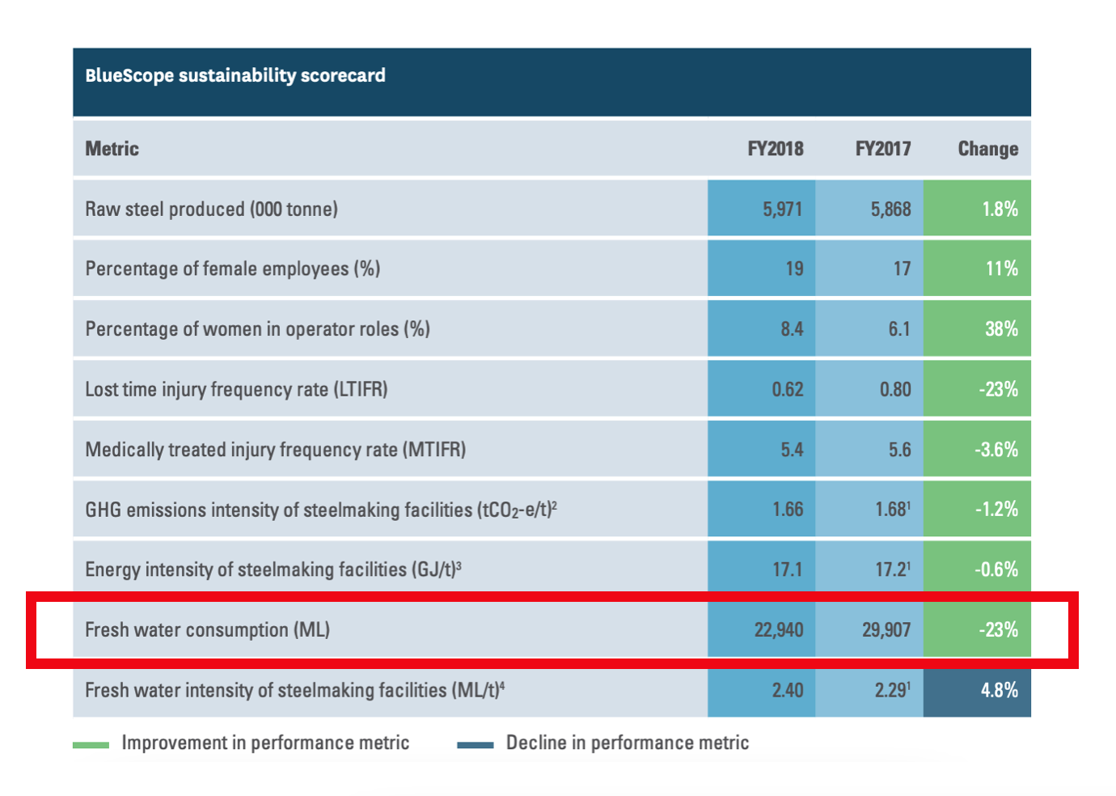
Project analysis slide 7
Exemplary Analysis
Example of Success
BlueScope, a metal fabrication company, saved about 23% of its total water consumed by fabrication processes through adopting water recycle and reuse mechanisms.

Slide 11
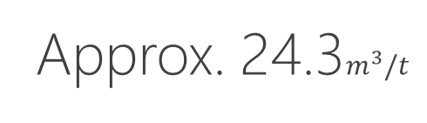
Project analysis slide 5
Projected Outcomes
SHORT TERM
LONG TERM
ONGOING
Approx. 8%
Approx. 33%
Approx. 24.3$m^{3}/t$
Data from BlueScope Steel Fabrication – 1st Year Water Consumption Decrease
Of all water consuming fabrications will be affected by the policy upon full integration of the scheme.
Of water can be reduced per year will be affected with reuse and recycling.

Slide 12
Prosperity made Possible
Thank You

